Slide 1


Presented by
Assistant I. Hazim Mohamed Ali
How to write a paragraph…
College of Basic Education,
University of Diyala
2016 - 2017
Notes:
Grammar and word choice are important for all your classes, not just English.

Slide 2
The Eight Parts of Speech
Noun. Ali, Suha, teacher, Iraq, door, snake….etc.
Verb. Play, write , open, walk, wash….. etc
Adjective. Good, smart, clever, red, Iraqi, big, tall..etc
Adverb. Slowly, usually, ago…… etc
Pronoun. I, he, she, it, they, we, you.
Preposition. In, on, at, to…… etc
Conjunction. For, and, so, yet, but, that, or…… etc
Interjection. How, what……etc

Slide 3

What is the meaning of the sentence and how many types are there in English Language?
A sentence is a group of the words that
gives us an idea.
There are four types of the sentences.
Simple sentence.
Compound sentence.
Complex sentence.
Compound and Complex sentence

Slide 4
Simple Sentence.
A simple sentence has one subject and one predicate.

Slide 5

Simple Sentence.
Pronoun
Verb
Prepositional phrase
We went to Baghdad yesterday.
Simple subject
Complete predicate

Slide 6


HOW TO WRITE A PARAGRAPH

Slide 7

What is a paragraph?
A paragraph is a piece of writing that consists of one or more than one sentence..

Slide 8
PARTS OF A PARAGRAPH
A paragraph has three parts:
1. Topic Sentence: It is usually the first sentence in a paragraph.
2. Supporting Sentences: They support the information of the topic sentence. It includes specific details
3. Conclusion: It reminds what the topic sentence was about.

Slide 9
PARAGRAPH SAMPLE
My favorite teacher is Salwa Ma’m. She is my class teacher. She is strict but funny. She tells lots of jokes when she teaches. She teaches us good songs. She gives us sweets on her birthday and festivals. We all stay quiet when she teaches. She makes sure that we understand the subject very well. At the end of the class Ma’m asks us questions. Most of my friends also like her very much. She is very caring and lovely. We wish her all good things in her life.
Red is the topic sentence
Blue is the supporting details
Brown is the conclusion.

Slide 10

PROCESS TO WRITE
A PARAGRAPH

Slide 11

There are five steps to write
a good paragraph.

Slide 12

1. Brainstorming
In this step you should think and write down any ideas about a topic you want to write about.

Slide 13

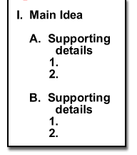
2. Order ideas
In this step you should organize your ideas by creating a cluster or an outline about what you want to write about.
Cluster
Outline

Slide 14
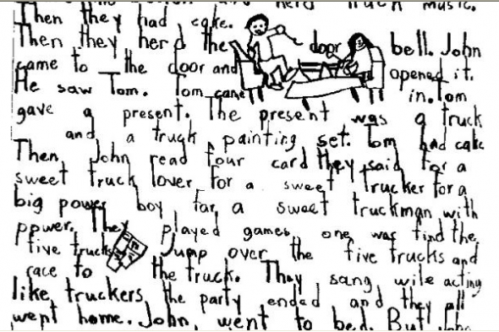
In this step you should write your paragraph for the first time, not taking much into account about the cohesion, coherence grammar, or spelling.
3. WRITING THE FIRST DRAFT

Slide 15
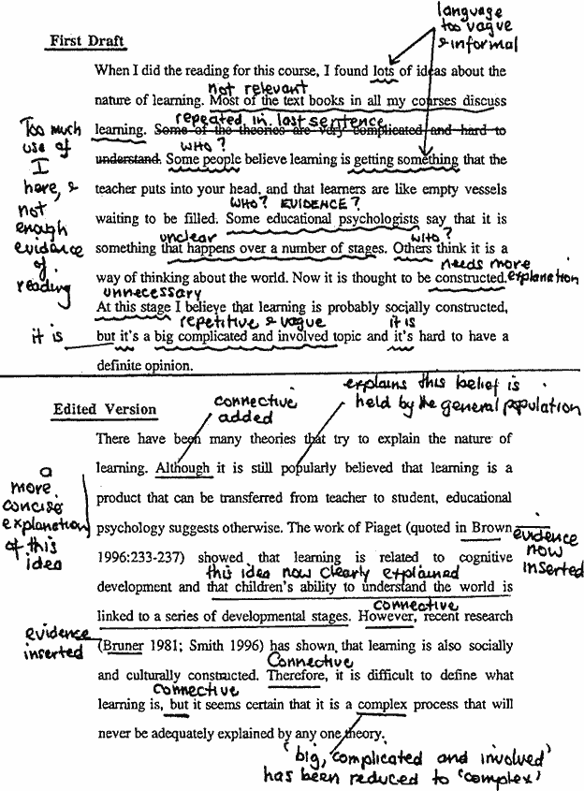
4. EDITING
In this step you should revise all the errors about coherence and cohesion that your paragraph may have.

Slide 16

5. FINAL WORK
In this step you should revise all the spelling or grammar errors. And that’s it. Your paragraph is done !

Slide 17
Some of rules that you should follow them before start your writing.

Slide 18
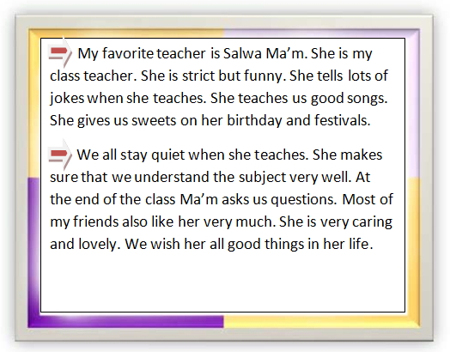
1. Indent
In this step you should leave 3 – 5 spaces before every paragraph.

Slide 19
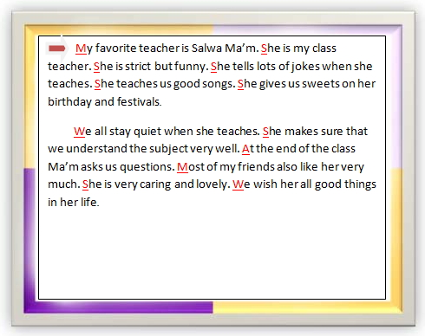
2. Capital letter
In this step you must use capital letter at the beginning of every sentence.

Slide 20
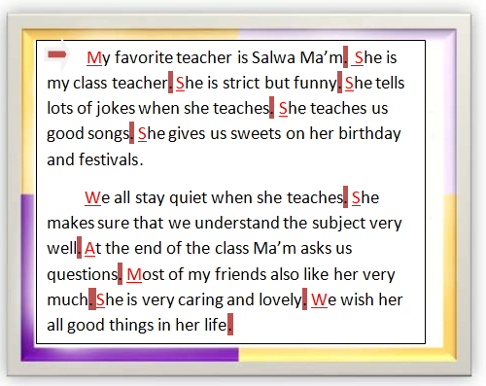
3. Use period
In this step you must use period at the end of every sentence.

Slide 21
4. point form
In this step you must not use point form sentences.

Slide 22


5. Contraction
In this step you must not use contraction like this way.
isn’t = is not
shan’t = shall not
don’t = do not

Slide 23
6. There is , there are
Avoid to use there is, there are:
There are many issues that students face of university.
Students face many issues at university.

Slide 24
7. Really, very, a lot of
Avoid to use really, very, a lot of:
Many students think university is very hard.
Many students think university is difficult.
Bill 399 is really controversial.
Bill 399 is controversial.
A lot of the students.
Many students. Students is countable.
A lot of time is wasted. Time is uncountable.
Much time is wasted.

Slide 25
Thank you
Presented by
Assistant I. Hazim Mohamed Ali
Department of English

